Slide 1
Types of inheritance in java
There are three types of inheritance in java:
Single
Multilevel and
Hierarchical.
In java programming, multiple and hybrid inheritance is supported through interface only.

Slide 2
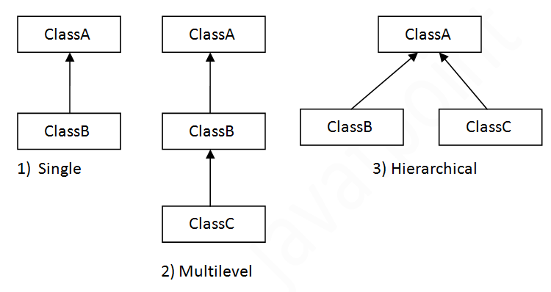

Slide 3
Single Inheritance
class Animal
{
void eat()
{System.out.println("eating...");}
}
class Dog extends Animal{
void bark()
{System.out.println("barking...");}
}
class TestInheritance{
public static void main(String args[]){
Dog d=new Dog();
d.bark();
d.eat();
}}

Slide 4
Output:
barking...
eating...

Slide 5
Multilevel Inheritance
class Animal{
void eat()
{System.out.println("eating...");}
}
class Dog extends Animal{
void bark()
{System.out.println("barking...");}
}
class BabyDog extends Dog{
void weep(){System.out.println("weeping...");}
}
class TestInheritance2{
public static void main(String args[]){
BabyDog d=new BabyDog();
d.weep();
d.bark();
d.eat();
}
}

Slide 6
Output:
weeping...
barking...
eating...

Slide 7
Hierarchical Inheritance
class Animal{
void eat()
{System.out.println("eating...");}
}
class Dog extends Animal{
void bark()
{System.out.println("barking...");}
}
class Cat extends Animal{
void meow()
{System.out.println("meowing...");}
}
class TestInheritance3{
public static void main(String args[]){
Cat c=new Cat();
c.meow();
c.eat();
//c.bark();//C.T.Error
}}

Slide 8
Output
meowing...
eating...

Slide 9
Write a program in which
Class A
{ void init(){ initialize two variable a,b}}
Class B extends A
{ void add(){ c= a+b}}
Class C extends A
{ void sub(){ c= a-b}}
Class D extends A
{ void div(){ c= a/b}}

Slide 10
class Abcd {
int a,b;
void init()
{
a = 10;
b=5;
}
}
class B extends Abcd
{int c;
void add()
{
c =a+b;
System.out.println(c);
}
}
class C extends Abcd
{int c;
void sub()
{
c =a-b;
System.out.println(c);
}
}
public class Abc
{
public static void main(String a[])
{B x=new B();
x.init();
x.add();
C y=new C();
y.sub();
}
}

Slide 11
15
0

Slide 12
package inheritance; CASE 1: Class D does not inherit with in the same package
class A {
protected int i;
}
class B extends A {
protected int j;
public int k;
}
public class C extends B{
protected int x;}
class D{
public static void main(String args[])
{
C cc= new C();
cc.i=10;
cc.j=20;
cc.k=30;
cc.x=20;
System.out.println(cc.i+" "+cc.j+" "+cc.k+" "+cc.x);
} }

Slide 13
Error

Slide 14
package inheritance; CASE 2 : Class D Inherit with in the same package
class A {
protected int i;
}
class B extends A {
protected int j;
public int k;
}
public class C extends B{
protected int x;}
class D extends C{
public static void main(String args[])
{
D cc= new D();
cc.i=10;
cc.j=20;
cc.k=30;
cc.x=20;
System.out.println(cc.i+" "+cc.j+" "+cc.k+" "+cc.x);
} }

Slide 15
Error main method not found

Slide 16
CASE 3: Class D Inherit with different package
package inheritance;
class A {
protected int i;
}
class B extends A {
protected int j;
public int k;
public void display(){
System.out.println(j+" "+i+" "+k);
}
}
public class C extends B{
protected int x;}
package newpackage;
import inheritance.C;
class D extends C{
public static void main(String str[]){
D cc=new D();
cc.k=10;
cc.j=20;
cc.i=30;
cc.x=20;
System.out.println(cc.i+" "+cc.j+" "+cc.k);
}
}

Slide 17
30 20 10

Slide 18
CASE 4: Class D not Inherited and in different package
package inheritance;
class A {
protected int i;
}
class B extends A {
protected int j;
public int k;
public void display(){
System.out.println(j+" "+i+" "+k);
}
}
public class C extends B{
protected int x;}
package newpackage;
import inheritance.C;
class D {
public static void main(String str[]){
C cc=new C();
cc.k=10;
cc.j=20;
cc.i=30;
cc.x=20;
System.out.println(cc.i+" "+cc.j+" "+cc.k);
}

Slide 19
Error: i, j, x, not in scope

Slide 20
CASE 5: Class D Inherit with different package but class c object
package inheritance;
class A {
protected int i;
}
class B extends A {
protected int j;
public int k;
public void display(){
System.out.println(j+" "+i+" "+k);
}
}
public class C extends B{
protected int x;}
package newpackage;
import inheritance.C;
class D extends C{
public static void main(String str[]){
C cc=new C();
cc.k=10;
cc.j=20;
cc.i=30;
cc.x=20;
System.out.println(cc.i+" "+cc.j+" "+cc.k);
}
}

Slide 21
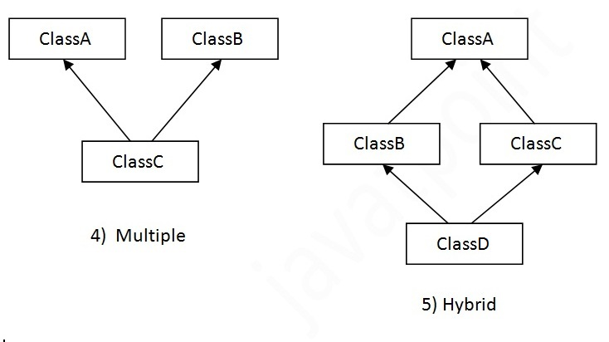
Multiple Inheritance
It is not allowed in Java through extends
When a class extends multiple classes i.e. known as multiple inheritance. For Example:

Slide 22
Why multiple inheritance is not supported in java?
Consider a scenario where A, B and C are three classes. The C class inherits A and B classes. If A and B classes have same method and you call it from child class object.

Slide 23
There will be ambiguity to call method of A or B class.

Slide 24
class A{
void add()
{a =10;
b=5;
c=a+b;}
}
class B{
void add()
{a =10;
b=5;
c=15;
d=a+b+c;}
class C extends A,B{//suppose if it were
Public Static void main(String args[]){
C obj=new C();
obj.add();//Now which add() method would be invoked?
}
}

Slide 25
To reduce the complexity and
simplify the language,
multiple inheritance is not supported in java.
Since compile time errors are better than runtime errors,
java renders compile time error if you inherit 2 classes.
So whether you have same method or different, there will be compile time error now.
Therefore, Inheritance is called Compile Time Mechanism.

